Slide 1
System Design Iteration 2
DSD 2020-1-9
Rui ZHANG

Slide 2
Contents
RA-Iteration II
SD-Iteration II

Slide 3
Gantt
We are HERE!
Role | Task | Week 1 | Week 2 | Week 3 | Week 4 | Week 5 | Week 6 | Week 7 | Week 8
P.M. | Team Construction
 | Progress Control
 | Iteration Evaluation
Liason | Team Communication
 | A.S.M.
R.A. | Customer Communication
 | Requirement Analysis
Arch. | System Design
 | Technique Route
Coder | Implementation
 | Functional Testing
Tester | Test Case Design
 | System Testing

Slide 4
1. RA Iteration II

Slide 5
`New Requirements’
English and Chinese translations
Automated /semi-automated algorithm shift
Status?
Popcorn?
Dog Ray?
Lucky Dog?
Happy Team?
Gourd Island?
Lengends?
Lenke classification

Slide 6
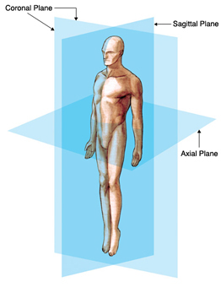
Lenke Classification
Scoliosis in 3D
Coronal Plane: front and back of the body
Sagittal Plane: left and right sides of the body
Axial Plane: looking from the top of the body to the bottom
Each scoliosis curve is then classified in three ways:
By the curve type based on which of the three regions of the spine; the proximal thoracic, main thoracic and thoracolumbar/lumbar is structural or non-structural;
a lumbar spine modifier based on the distance of the center of the lumbar spine to the midline; and
a sagittal thoracic modifier based on the amount of side (lateral) curvature to the thoracic region.
Reference: http://spinal-deformity-surgeon.com/leader-in-spinal-deformity/lenke-classification-system-for-scoliosis/

Slide 7
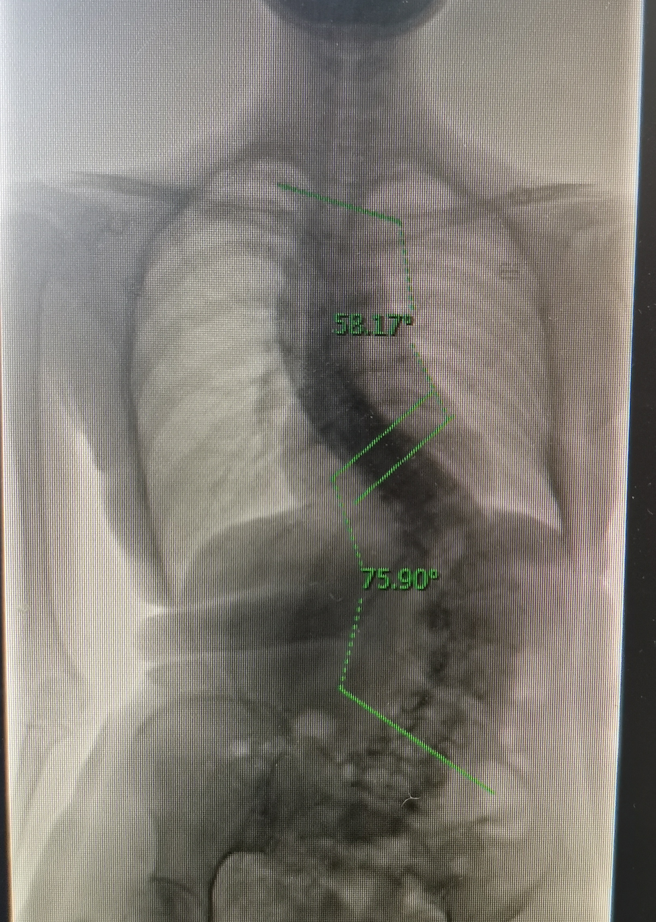
Lenke Class. Ctn.
Every aspect of the curve is also evaluated for its relative stiffness or flexibility on side bending x-rays. The triad system, therefore, combines
the curve type (1-6)
with the lumbar modifier (A, B, C)
and the sagittal thoracic modifier (-, N, +)
to form the complete classification. The most common type is a “1AN” curve classification.
An example from Prof. YIN,
Lenke 6, Cobb_lumbar – Cobb_thoracic > 10°

Slide 8
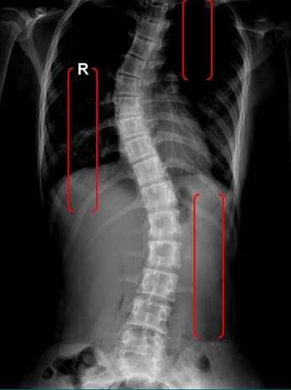
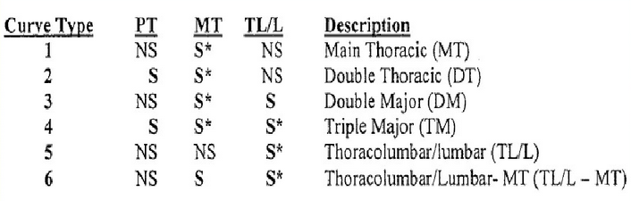
To compute Lenke…
Spine segmentation
Proximal thoracic, PT
Main thoracic, MT
Thoracolumbar, TL
Lumbar
Spine recognition
AI
Cobb computation
Function
Lenke classification
Rules
Reference: https://wenku.baidu.com/view/6b34bc7d9b89680202d8254d.html

Slide 9
2. SD Iteration II

Slide 10

Server
Setting
Accessibility
Usability
Strategy
1 out of 3
3 in order

Slide 11

Homework
Document revision
Code pull
Server set up
Integration test

Slide 12
Thanks!

